Slide 2
Best of Build 2021: Azure Functions
Callon Campbell
Microsoft MVP Azure
@flying_maverick

Slide 3
Agenda
Announcements at Build 2021
Demo
Q&A

Slide 4
Announcements at Build 2021
Microsoft made two announcements related to Azure Durable Functions:
Durable Functions for PowerShell is now GA
Two new backend storage providers
Notes:
In this session I’ll just be covering the new Durable storage providers.

Slide 5
Durable Functions in 30 seconds
Durable Functions is an extension of Azure Functions
Enables you to write long-running, reliable, event-driven, and stateful logic
Simplifies complex, stateful coordination requirements in serverless applications
Execution state is saved in an Azure Storage account, ensuring that functions could recover automatically from any infrastructure failure
Notes:
Is an extension of Azure Functions
Allows you to write long-running, reliable, event-driven, and stateful logic while simplifying complex, stateful coordination in serverless applications
The execution state is saved in an Azure Storage account, ensuring that functions can recover automatically from any infrastructure failure
Ideal for situations where you want to chain functions together, fan-out/fan-in, HTTP API Async, Monitoring, Waiting on user interaction

Slide 6
New Storage Providers
Support for two new backend storage providers for storing durable runtime state, “Netherite” and Microsoft SQL Server (including full support for Azure SQL Database).
These new storage options allow you to:
Run at higher scale
Greater price-performance efficiency
Greater portability compared to the default Azure Storage configuration
Notes:
Azure Durable Functions now supports two new backend storage providers for storing durable runtime state, “Netherite” and Microsoft SQL Server (including full support for Azure SQL Database).
These new storage options allow you to:
Run at higher scale
Greater price-performance efficiency
Greater portability compared to the default Azure Storage configuration

Slide 7
Limitations of Azure Storage Provider
Azure Storage has the following limitations:
Limits on the number of transactions per second
Strict data size limits for queue messages and Azure Table entities
Hard to predict costs
Can’t easily support certain enterprise business continuity requirements, such as backup/restore and disaster recovery without data loss
Azure only
Notes:
The default Azure Storage configuration provider does have some limitations:
Has limits on the number of transactions per second for a storage account
Has strict data size limits for queue messages and Azure Table entities
Costs can be hard to predict since they are per-transaction and have very limited support for batching
Can’t easily support certain enterprise business continuity requirements, such as backup/restore and disaster recovery without data loss
Can’t be used outside of the Azure cloud

Slide 8

Introducing “Netherite”
The Netherite name originates from the world of Minecraft
Developed by Microsoft Research, it combines Azure Event Hubs with the FASTER database technology on top of Azure Page Blobs
Supports significantly higher-throughput of orchestrations and entities compared to other Durable storage providers
More cost-effective for high-throughput loads
Notes:
Looking at the GitHub repos - “Netherite” comes from the world of Minecraft and is the name of a rare material that is more durable than diamond, can float in lava, and cannot burn.
The Netherite storage provider aspires to have similar qualities, but in the context of Durable Functions.
Developed by Microsoft Research, it combines Azure Event Hubs with the FASTER database technology that sits on top of Azure Page Blobs
Supports significantly higher-throughput and is more cost-effective for high-throughput loads

Slide 9
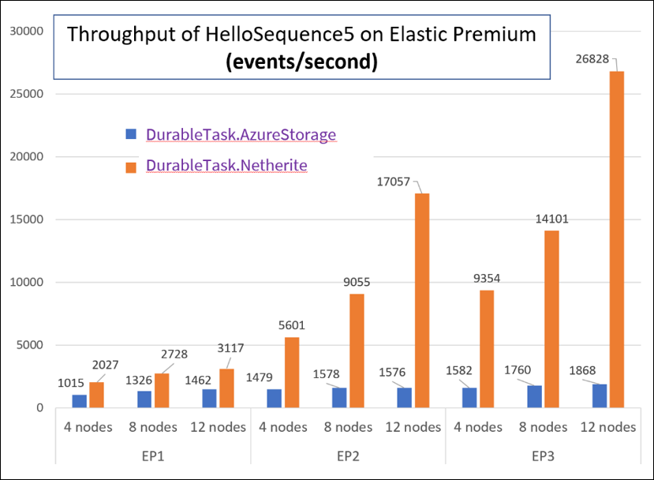
Performance Benchmark
Single Azure Event Hubs throughput unit (1 TU), costing approximately $22/month USD on the Standard plan, running a simple function-chaining sample with 5 activity calls running on the Azure Functions Elastic Premium plan.
Notes:
The orchestrator used in this test is a simple function-chaining sample with 5 activity calls running on the Azure Functions Elastic Premium plan.
As you can see the Netherite provider has considerable throughput compared to Azure Storage.

Slide 10
Introducing SQL Server Provider
SQL Server provider allows Durable Functions to run anywhere
Azure SQL Database
On-premises
Docker Containers / Kubernetes
IaaS
Multi-Cloud
Leverage your existing SQL Server investments
Backup/restore
Failover
Encryption
Compliance
Easily integrate with existing SQL-based applications
Notes:
While the Netherite provider was designed for maximum throughput, the Microsoft SQL Server provider for Durable Functions is designed for the needs of the enterprise, including the ability to decouple from the Azure cloud.
With the ability to run Microsoft SQL anywhere, including on-premises servers, Edge devices, Linux Docker containers, on the Azure SQL Database serverless tier, and even on competitor cloud providers like AWS and GCP. This means you can run Durable Functions anywhere that Azure Functions can run, including your own Azure Arc-enabled Kubernetes clusters.
The design of the Microsoft SQL storage provider for Durable Functions also makes it easy to integrate with existing SQL-based applications. When your function app starts up, it automatically provisions a set of tables, functions, and procedures in the target database within a “dt” schema (“dt” stands for Durable Tasks).
You can easily monitor your orchestrations and entities by running SELECT queries against these tables.

Slide 11
Demo: Configuring alternate storage providers

Slide 12
Choosing the right storage option
Azure Storage
Netherite
SQL Server
Generally available
Dependencies:
Azure Storage Account (general purpose v1)
Minimal setup
Lowest minimum cost
Consumption plan: Yes
Elastic Premium plan: Yes
Disconnected support: No
Public preview
Dependencies:
Azure Event Hubs
Azure Storage Account
Max throughput
Lower cost at scale
Consumption plan: No
Elastic Premium plan - requires runtime scale monitoring
Disconnected support: No
Public preview
Dependencies:
SQL Server 2019 or Azure SQL Database
Runs anywhere
Enterprise friendly
Consumption plan: No
Elastic Premium plan- requires runtime scale monitoring
Disconnected support: Yes
Notes:
The choice to use storage providers other than Azure Storage should be made carefully. Most function apps running in Azure should use the default Azure Storage provider for Durable Functions. However, there are important cost, scalability, and data management tradeoffs that should be considered when deciding whether to use an alternate storage provider.

Slide 13
Wrap up
Netherite and SQL Server providers are in preview
Development of these new backends is open on GitHub:
https://github.com/microsoft/durabletask-netherite
https://github.com/microsoft/durabletask-mssql
Either of these storage providers can be configured without any code changes

Slide 14






Let’s Connect
Callon Campbell
Technical Architect | Developer
Cloud Mavericks Inc.
Microsoft MVP Azure
Callon@CloudMavericks.ca
@flying_maverick
https://LinkedIn.com/in/CallonCampbell
https://GitHub.com/CallonCampbell

Slide 15
References
Netherite docs
Netherite whitepaper
Development of these new backends is open on GitHub:
https://github.com/microsoft/durabletask-netherite
https://github.com/microsoft/durabletask-mssql
Premium Elastic plan – Configure Runtime Scale Monitoring
Durable Functions storage providers - Azure | Microsoft Docs
Comparing storage providers - Azure | Microsoft Docs
Demo and presentation on my GitHub

Slide 16
Learn.
Connect.
Code.

Slide 18
Text layout (without bullet points)
Main topic: Segoe UI, size 28pt
Segoe UI, size 20pt for second level
Segoe UI, size 16pt for third level

Slide 19
Learn.
Connect.
Code.

Slide 20
Learn.
Connect.
Code.

Slide 21
Learn.
Connect.
Code.

Slide 22
Apprenez.
Échangez. Programmez.

